Slide 1
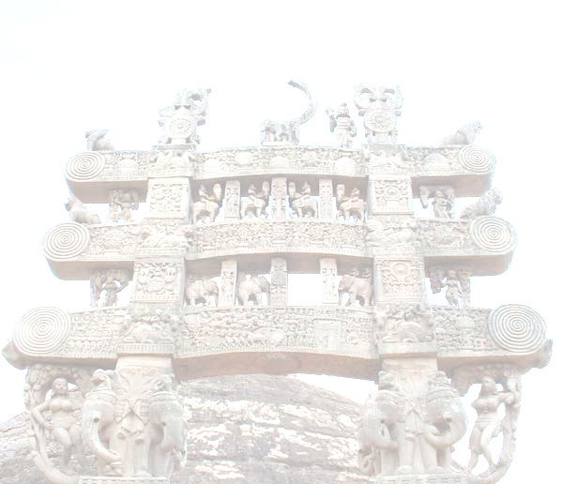
BUDDHIST ARCHITECTURE
Buddhist School under Asoka
Mauryan Pillars
Lion Pillar at Sarnath
Evolution of the Stupa during the Sungas and Andhras 185BC-150AD
Sanchi Stupa

Slide 2
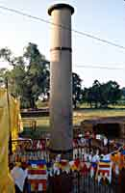
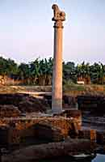
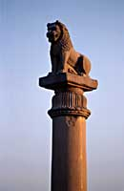
MAURYAN PILLARS
INTERACTION OF HELLENIC AND INDIAN IDEAS IN NORTH INDIA
Like Egyptian pharaohs they built everlasting monuments in honor of the gods
Ashoka showed THE ENDURANCE OF THE GOOD LAW
· Thus arose the pillar for a beginning which was 50' high which carried the Buddhist emblem
· Other monolithic productions were
Railings
Stupa finials- umbrellas
Lion thrones
Colossal figures
Hypostyle halls at the royal palaces of Pataliputra
· Most important aspect of these stone structures was the smooth enamel finish
· This was the infancy of stone architecture and yet it reached its peak immediately after wood
· Stone art developed even without a background and traces of Greek, Persian and Egyptian
· Influence in the method of usage of stone could be seen.
· The Graeco-Persian culture influence in Indian art could be seen from above examples
Source of inspiration-
· Pharoic-Hellenic-Iranian elements
· Spread by Alexander's conquest of Persia together with the downfall of Achaemenid Empires
· Downfall in 330 BC, which ensured the rise of the Macedonian empire by the extension
of Greek colonies to east till the borders of the Mauryan Empire
· This was the time when Ashoka wanted to build, so he used the workmen already proficient in
· the palaces of the Persian kings
· · Ashokan pillars similar to the columned hall of Achaemenid Kings
· various inscriptions from Behistun
· Stone was native at Chunar quarry in Bihar

Slide 3
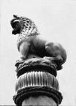
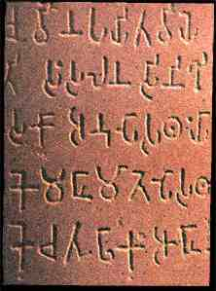
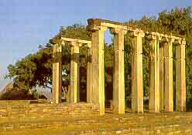
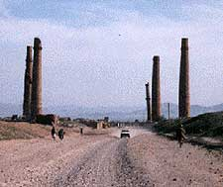
MAURYAN PILLARS
Originally there were 30 in number of which only 10 exist
· 2 lion capitals in Bihar
· erected at sites sanctified by Buddha and routes to holy sites
· line of pillars at Champaran and Muzzaffarpur districts are classic examples
· No pillar is isolate, there is always a stupa in the vicinity
Each pillar consisted of
· a plain ornamental shaft circular in section 30' - 40' high
· No base, straight from the ground and tapering towards top
· Top of the shaft was 2' in dia
· On top is the campaniform capital ( Bell shaped) its abacus acting as a
· A base for the Buddha symbol.
· total height was 50 '
In due course of time it was worshipped, which existed even before-
shown by the bas relief’s of barhut- 150 BC
· columns were gods in early days and the forerunner of temples
Aesthetic quality-
concentrated on the superstructure
· around 7' in height
· made of a single piece of stone with the shaft in another piece
· Both fitted by a copper bolt by tenon joint without cement
· the bolt was barrel in shape 2' long
· iron was not used because they probably knew the rusting property of iron
· Capitals are 3' in dia-campaniform in shape
· fluted petals falling down taking the shape of a bell
· The one at Nandan garh was stunted-probably the 1st one on an experimental basis

Slide 4
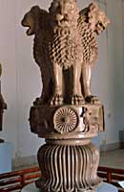
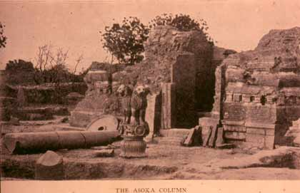
MAURYAN PILLARS
Fluting is of foreign origin from the Persian and Greek pillars
Palace of Artaxerxes at Susa built in 404-358 BC contains fluting
· Ionic temples of Apollo at Diona at Ephesus- 560 BC
· Above the capital is a circular abacus with a broad edge
· carved with ornamental border of a special character
· On this the repetition of Buddhist emblems like
goose-hamsa
honey suckle
palmette
bead and fillet
cable molding
all derivatives of Hellenistic ideas, even though they
· Above the abacus mostly animals adorned the pillar
· Symbolizing the four quarters of the universe.
Elephant guardian of the east
Horse -south
Bull- west
Lion- North
LION CAPITAL - SARNATH
The Lion capital is a polished sandstone carving of four lions atop an abacus (the slab forming the top of a column).
The lions are facing in four directions and on the abacus are eight images.
Immediately below each lion is a dharmachakra, or wheel, with twenty-four spokes.
This wheel has been incorporated into the national flag of India.
Between the wheels are four animals – a lion, a horse, an elephant and a bull.
Falling from the abacus is an upturned, bell-shaped lotus flower.
The pillar at Sarnath was 50’ tall and carried a Schism Edict addressed to the mahamattas at the monastery at Sarnath, which read ‘No one shall cause division in the order of monks’.

Slide 5
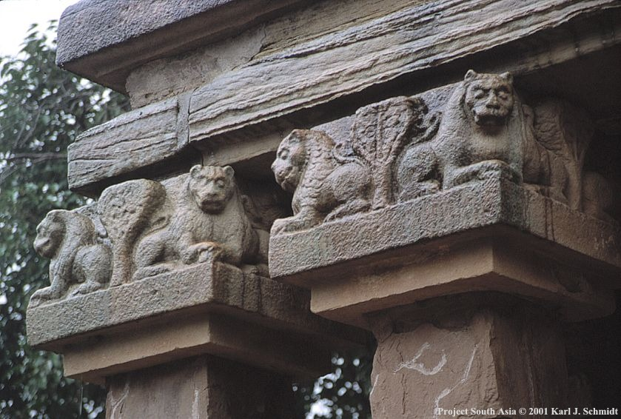
LION CAPITAL - SARNATH
· The monks and the monastery have long since disappeared, but Sarnath remains an important place for Buddhists, as it is the place where the Buddha gave his first sermon.
· Modern scholars argue about the provenance of the pillar, with some claiming that its design may have been influenced by Alexander the Great.
· Because lions are not generally part of Indian culture, it is suggested that there is a Hellenistic influence at work in the design.
· There is a wheel on top of the animals
· The animals were an inspiration from the Vedic period
· the Rig-Veda places
the lion in the 1st Place
Horse- sun
Bull-Indra God/Dyaus/Sky god
Thus it is a continuation of the Vedic mythology.
· It was boldly designed
· Finely proportioned
· Well balanced conception
· Satisfying the purpose being
Monumental
It was not a part of any architectural composition
· The wheel was of metal at Sarnath
· The limbs and tense muscular anatomy depict Greek Hellenistic achievements
· Lion head spouts of Greek
· Detailing is remarkable
LION PILLARS AT SANCHI

Slide 6
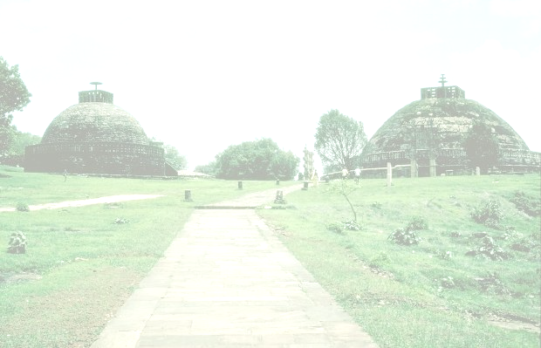
BUDDHIST STUPA - 250 BC
· Evolution of the Stupa
The first Buddhist 'shrines' were mere piles of stone or rubble containing relics of the Buddha.
· Over time it became necessary to 'upgrade' these structures, in conformity with Buddhism's rising status.
· For structural reasons it was necessary to have a wide base, tapering towards the top.
· The form chosen for the Buddhist Stupa was that of a sphere - as much for the shape's metaphysical associations as for the fact that it was an antipode to the square/rectangular form of Hindu temples.
· "The embryo of the most powerful architectural form of Buddhism, the famous Stupa, thus emerged for the first time under the architectural patronage of Ashoka".
Characteristic features of a Stupa
The Stupa was the most sacred symbol of the Buddha
These were tumuli of brick with a great spiritual significance
Normally consisted of:
Masonry hemisphere 70’ 0” dia.,35’0” high
Solid of large unburnt bricks each around 16”x10”x3”
In the center of this mound or Anda was a small space for a receptacle containing the relic of the Buddha
On the summit was an honorific umbrella – wooden parasol Chattrayashti
The brickwork of the stupa was finished of with a thick layer of plaster in which recesses were left at intervals for small lamps to be lit during festivals
A certain amount of colour and gilding was also applied, furnished with festoons of flowers and drapery with banners and flags
The buddhist practice of circumambulation was in the form of a processional passage or Pradakshina Patha
It was enclosed in a wooden railing- Vedika leaving a space for promenading with an entrance at each of the cardinal points
Surmounted by a finial or the Harmika The harmika on top represented the Bodhi Tree under which the Buddha first gained enlightenment.
Ashoka used wood and bricks whereas Sungas used stone

Slide 7
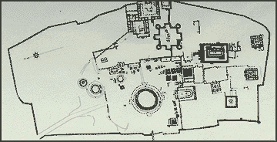
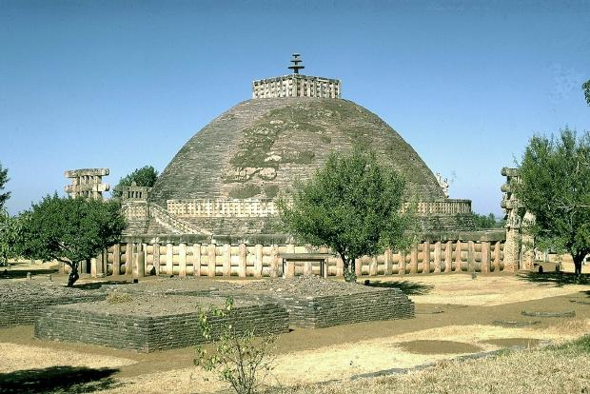
SANCHI STUPA - 150 BC
After the end of the Mauryan dynasty in 185 BC we had the Sungas taking over and ruling till 70 BC in the N and W regions
The Sungas were tolerant to the Buddhists
During the Sungan period we had the main change being- improvement of the stupa into a more dignified architectural structure
Replacement of the impermanent materials with permanent materials such as stone
This is understood by analysing the alterations made to surviving egs., the chief one being Sanchi
Details
Reconstructed around 150 BC
Enlarged to nearly twice the size retaining the original Brick tumulus of Asokan period
The Stupa was hence encased within an envelope – Achchaday
The structure was hence 120’0” dia. 54’0” high
A terrace- Medhi was added 16’0” from the ground providing a separate lower and upper ambulatory
Access to the medhi was on the S side by a double stairway- Sopana

Slide 8
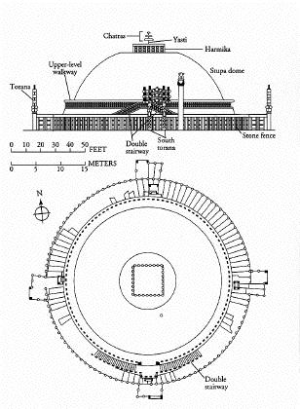
SANCHI STUPA
The whole structure is finished by means of dry masonry of hammer dressed stones laid in even courses
The Anda is flattened on the top and is surmounted by a square railing enclosing a pedestal- Harmika which supported the shaft- Yashti and a triple umbrella- Chattri made of stone
This form of the finial is seen only in the earlier Stupas, which developed into a shape resembling an inverted stepped pyramid or cone in later egs.
The work during Asoka’s period of the wooden palisade structure is hence lost
The structure has projections at the cardinal points
There are large elaborately carved gateways or Toranas providing access to the Stupa
The Toranas are designed in a Swastika pattern thereby enabling privacy for the m,monks using the Pradakshina Patha inside
The Toranas are provided with relief work based on tales from the Jataka or stories from the life of the Buddha

Slide 9
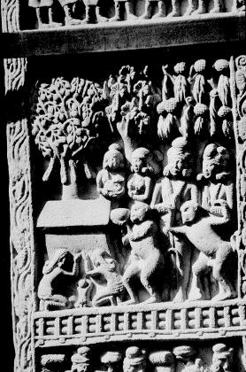
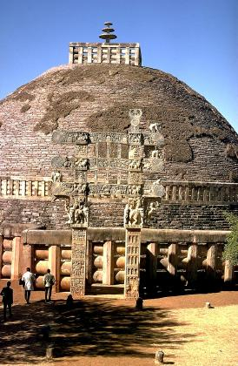
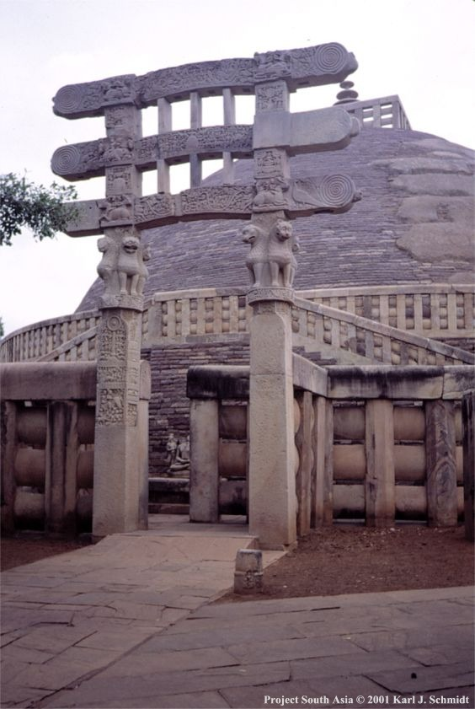
SANCHI STUPA
Vedika-
  made entirely of stone
  1100” high with an entrance in each of the cardinal points
  The emblem of protection from the Vedic times
  Large in proportion and austere in treatment
  Uprights consist of octagonal posts 9’0” high placed at an interval of 2’0” in between
  Three horizontal bars or rails connect these posts, each 2’ wide and separated by a narrow space of 3.25”
  An immense beam was placed over this forming a coping stone to the whole
The reason for such a large barrier is not known, might have been to keep with the proportions and dimensions of the overall structure
As distinctive as the proportions of the railing was the construction
The railing is entirely of stone but is a copy of the wooden original it replaced
The shape and the joints of the railing are common to timber as seen in the tenon of the Thaba, and the scarf jointing of the coping- Ushnisha,
The triple cross bars- Suchi are derived from the bamboo rails of the palisade fence
The craftsmen were hence thinking in wood although they were working with stone

Slide 10
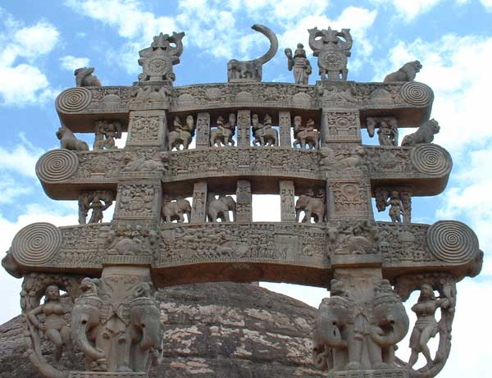
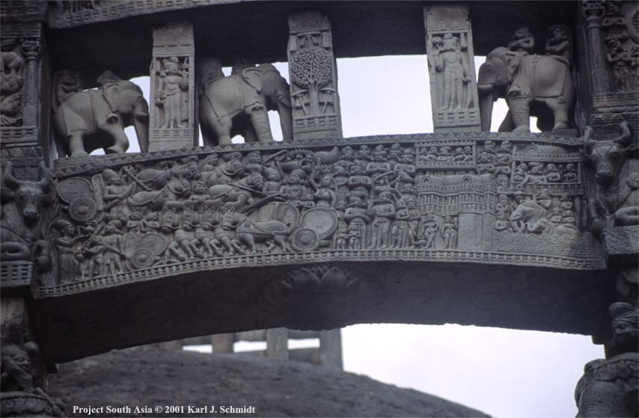
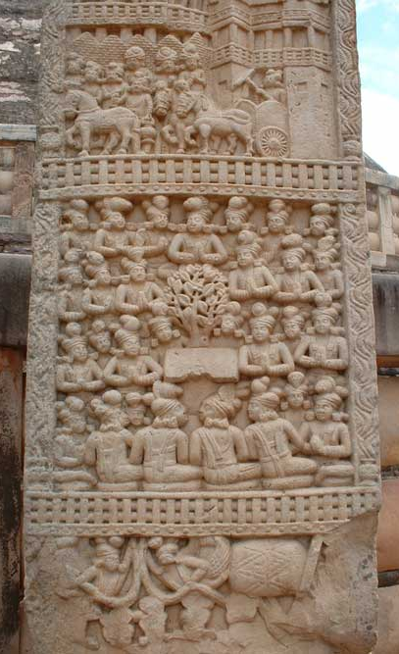
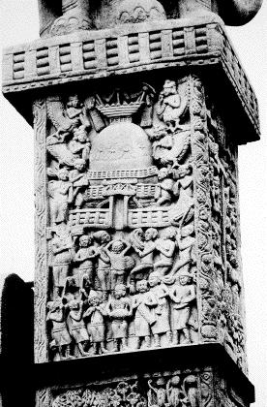
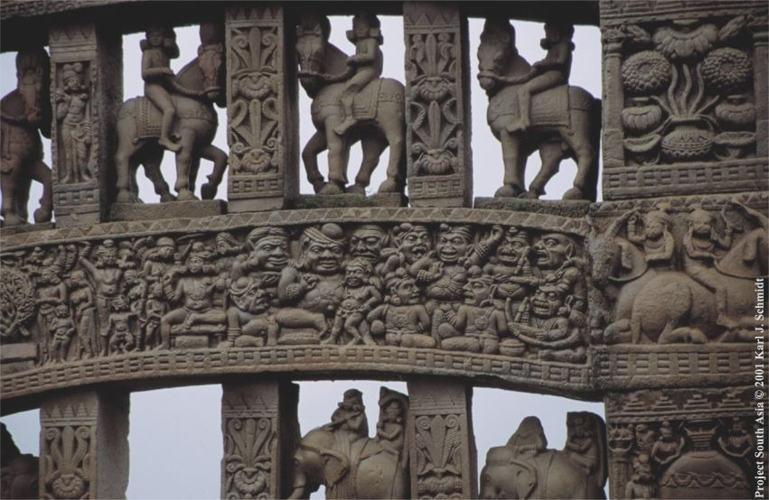
SANCHI STUPA

Slide 11
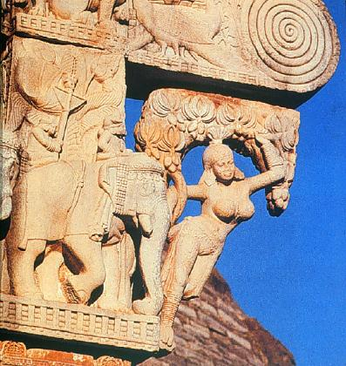
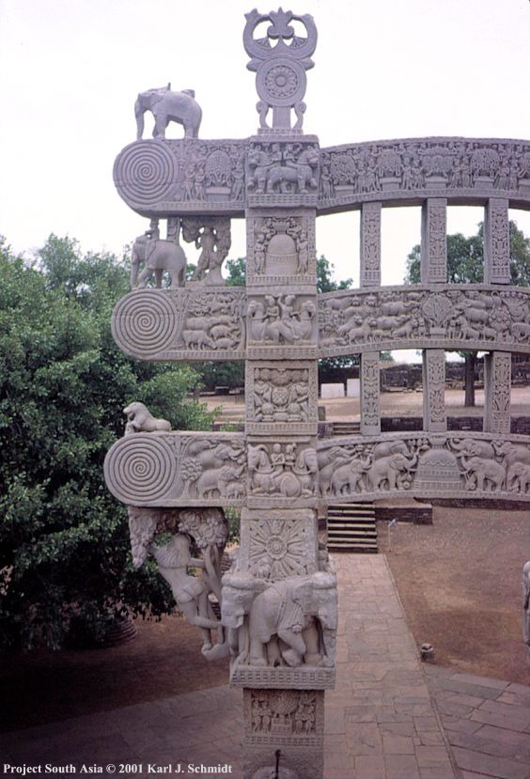
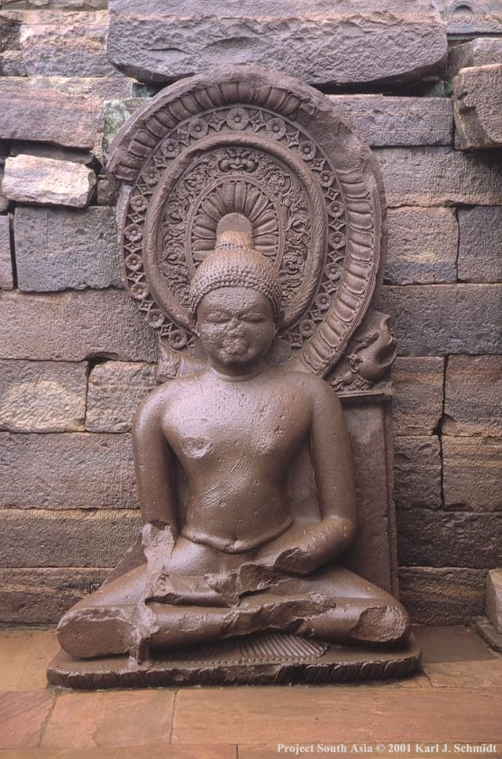
SANCHI STUPA
·
Ornamentation:
  Highly carved
  It was a copy of the wooden railing
A bit out of proportion
Inspiration from the megalithic stone age
Joints used are appropriate for wooden than for stone
Shows primitive craftsmanship
· Gateway
Square vertical posts totaling 34' high 2 thk.
Ornamental balusters in-between the horizontal members
The four gateways took 50 years
style remained constant
1st gate was built by Andhras in 75BC in the south
10 years gap for the N, E and W gateways
Best carved gateway on the south
Less detailed gateway on the north
South gateway bears inscriptions made by ivory carvers of Mortise holes to hang chains and bells
Decoration overtook construction techniques
It is compared to the Stonehenge(proportions)

Slide 12
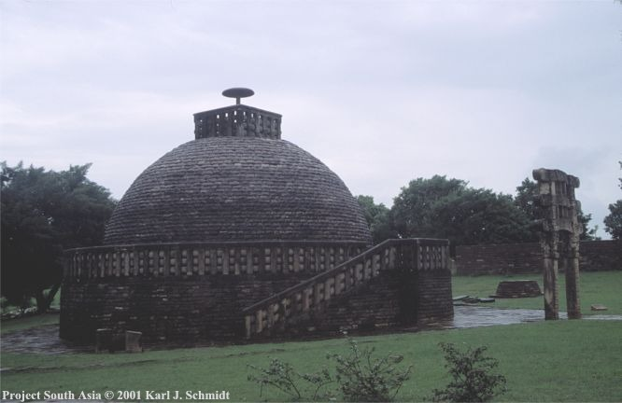
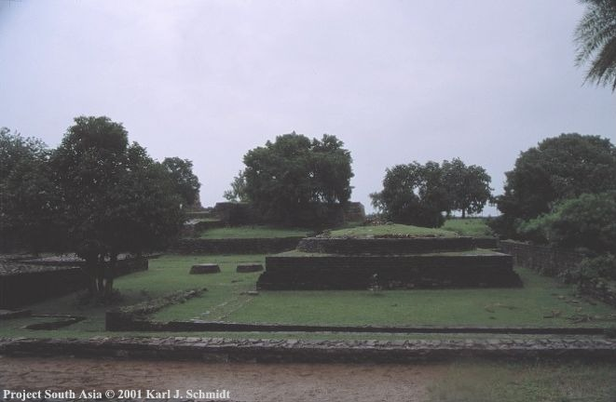
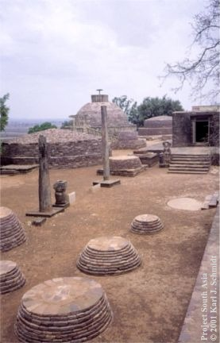
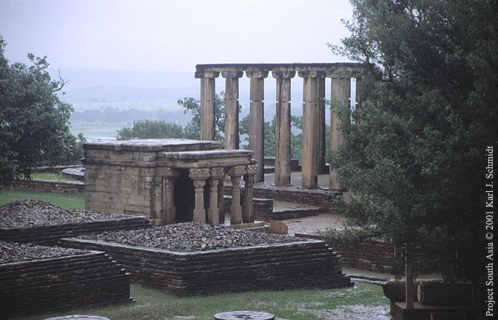
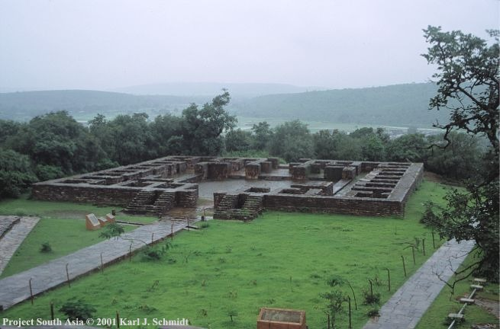
SANCHI STUPA
Torana:
The entrances to religious buildings were always imposing structures with ornamental treatment
The Torana ( tor in sanskrit is pass) was designed on the same principle as the bamboo and wood portcullis
It was an archway accepted as a ceremonial portal
There are 5 gateways in the complex- 4 for the main Stupa and one Stupa 3 added later
Consists of 2 square uprights 15’ high, prolonged vertically and connected by 3 separate lintels between each of which is a band of ornamental balusters
The total ht. Is 34’ with a width of 20’ at the broadest part
The thickness averages 2’ and it stands without support for 2000 years
Top heavy with a jointing which is highly irrational
Indigenous composition as there is no recognizable form of pillar or capital
In comparison with the unadorned railing the elegant intricacy of the gateways forms a contrast

Slide 13
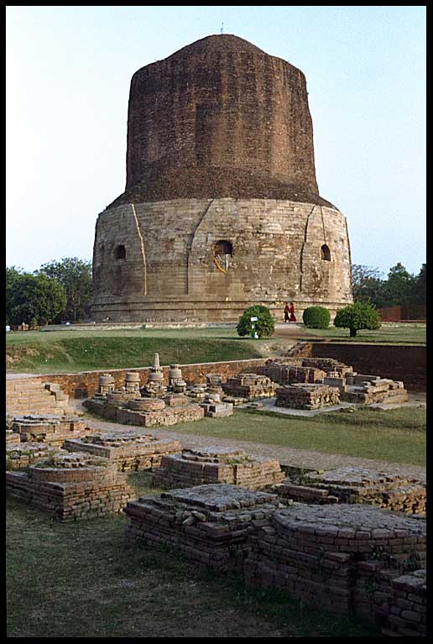
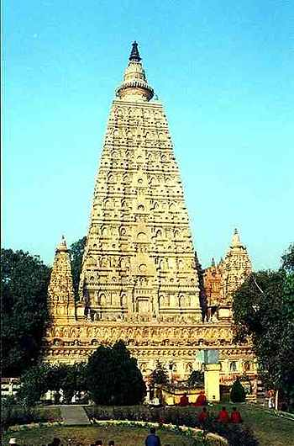
OTHER STUPAS
Sarnath
Barhut::
68’0” dia.with a reconstructed railing
Half the size of the great Sanchi Stupa
Railing was 7’0” high with rich carvings of the Jataka tales and social life
The torana in Barhut is the oldest surviving eg. Of 4 similar gateways built during the Sungas- 184-72 BC
Hellenistic influence obvious – fluted bell shaped capitals and use of the honeysuckle motif in the large acroteria at the apex
Bodh Gaya:
Quadrangular railing 145’ x 108’ conforming to the square plan of the building
Railing of 6’8” ht.
Presence of a Chankrama or promenade – pillared passage covered by a roof
The pillars had a stepped pedestal and vase shaped bases, decorated with a caryatid figure

